Slide 1
Sistemas de Informação II
(Information Systems)
Syllabus, Evaluation and Bibliography
Viriato M. Marques
Prof. Coordenador
DEIS – Departamento de Engenharia Informática e de Sistemas
ISEC – Instituto Superior de Engenharia de Coimbra

Slide 2
Syllabus
Information Systems
ERPs
SCM and CRM
Introduction to Business Inteligence
Introduction to Datawarehouses and OLAP
Design of a DW
Data Load - ETL
OLAP Systems
Balanced Scorecards and KPI’s
Client Applications
Reporting
SQL-Server BIDS – Application Development

Slide 3
Syllabus
Introduction to Data-Mining
General Vision
Data pre-processing
DM Taks: classification, clustering, association, regression, outlier detection
Development environments
Application Development on SQL-Server BIDS

Slide 4
Syllabus
Knowledge Management in Organizations
Knowledge Management Cycle
Knowledge types
Tem role of Information Systems: Sites, OLTP, OLAP, data-mining, IA techniques, help-desk, e-learning, geographical informaton systems
Introduction to Discrete Simulation
Principles and Modelling
Examples
Introduction to Application Development on ExtendSim

Slide 5
Syllabus
Project Management
International Information Systems

Slide 6
Evaluation
Evaluation
Final Practical Work (Group, 2 people): 10 points
Final Exam 10 points
There is no minimal mark for the exam or practical work
The best mark among normal, 2nd call or special September exam is always the one considered
There is no possible upgrade of the practical work: once presented, that will be the final practical work and mark

Slide 7
Bibliography
Slides
Management Information Systems, Laudon & Laudon, Prentice Hall
Data-mining Concepts & Techniques, Han & Kamber, Morgan-Kaufman
Supercharge PowerBI – Matt Allington, 2018
Business Intelligence, Santos & Ramos, FCA
Planeamento de Sistemas de Informação, Amaral & Varajão, FCA
SQL Server Management e BI Studio - Manuais

Slide 8
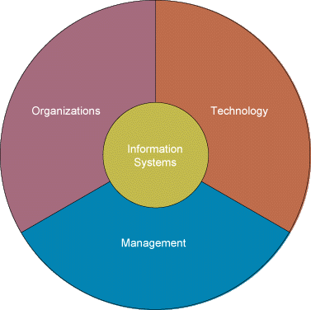
Sistemas de Informação II
Syllabus, Evaluation, Bibliography
The End
Information Systems

